Slide 1

DBMS-Data Modeling ERD
Uma Seshadri

Slide 2
Data base design - E R diagrams
For the following database Schemas draw ER diagrams.
Convert entities and relationships to relation tables
COLLEGE DATABASE:
STUDENT (USN, SName, Address, Phone, Gender) SEMSEC (SSID, Sem, Sec)
CLASS (USN, SSID)
SUBJECT (Subcode, Title, Sem, Credits)
IAMARKS (USN, Subcode, SSID, Test1, Test2, Test3, FinalIA)
COMPANY DATABASE:
EMPLOYEE (SSN, Name, Address, Sex, Salary, SuperSSN, DNo) DEPARTMENT (DNo, DName, MgrSSN, MgrStartDate) DLOCATION (DNo,DLoc)
PROJECT (PNo, PName, PLocation, DNo) WORKS_ON (SSN, PNo, Hours)

Slide 3
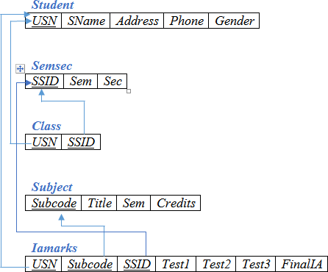
Mapping entities and relationships to relation table Student DB - Schema Diagram

Slide 4
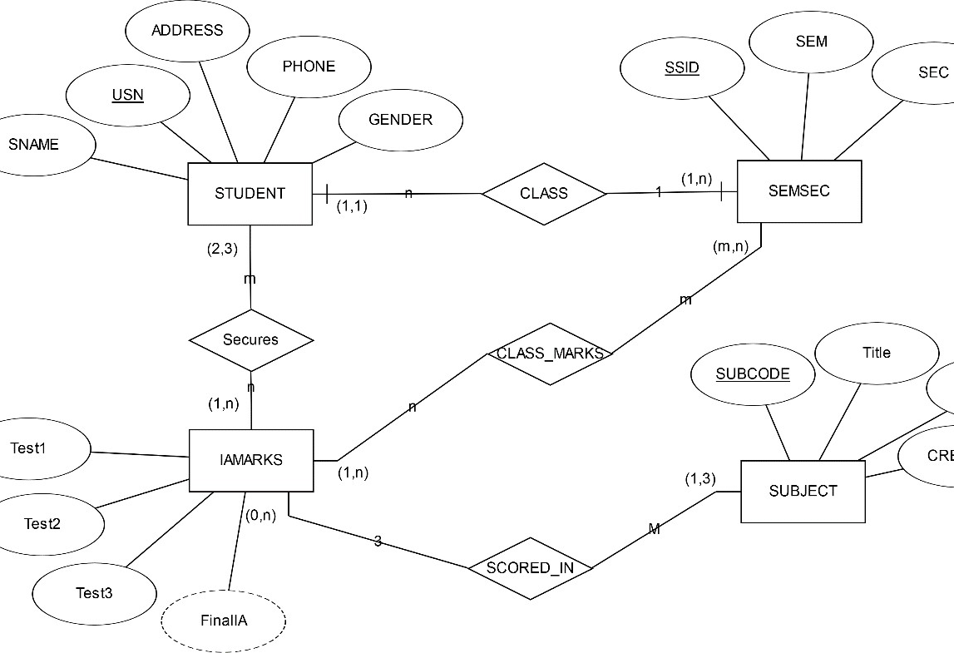
E R Diagram

Slide 5
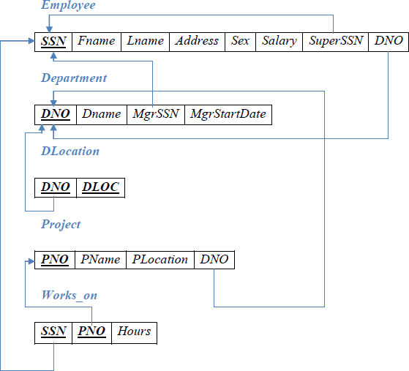
Schema Diagram – Employee DB

Slide 6
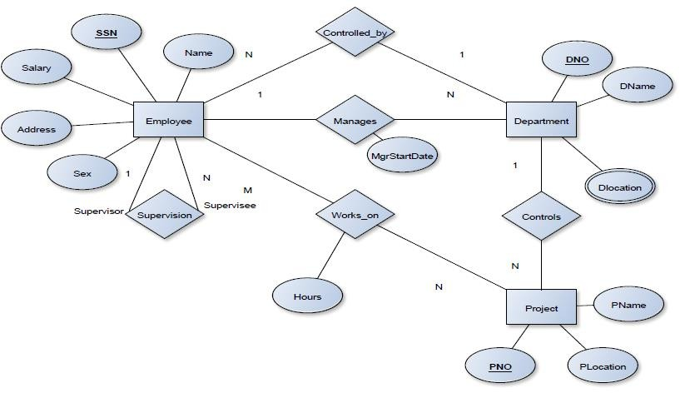
E R Diagram

Slide 7
Overview of Database Design
Conceptual design: (ER Model is used at this stage.)
What are the entities and relationships in the enterprise?
What information about these entities and relationships should we store in the database?
What are the business rules that hold?
A database `schema’ in the ER Model is represented pictorially by ER diagrams.
It can map an ER diagram into a relational schema

Slide 8
Conceptual design: ER Model is used at this stage.
Conceptual design follows requirements analysis
Yields a high-level description of data to be stored
ER model is popular for conceptual design
Constructs are expressive, close to the way people think about their applications.
Basic constructs: entities, relationships, and attributes (of entities and relationships).
Some additional constructs: weak entities, ISA hierarchies, and aggregation.
Note: There are many variations on ER model.
.

Slide 9
ER Model Basics
dname
Since
budget
manager
name
Address
ssn
Works in
Department
Employees
Entity: Real-world object distinguishable from other objects. An entity is described (in DB) using a set of attributes.
Entity Set: A collection of similar entities. E.g., all employees.
Relationship: Association among two or more entities. E.g., RAMESH works in Pharmacy department.
Relationship Set: Collection of similar relationships.
All entities in an entity set have the same set of attributes. (Until we consider ISA hierarchies, anyway!)
Each entity set has a key.
Each attribute has a domain

Slide 10
ER model : Key constraints
dname
name
Address
Since
location
ssn
budget
Employees
manage
Department
Reports to
subordinates
supervisor
Consider Works_In:
An employee can work in many departments;
A dept can have many employees.
In contrast, each dept has at most one manager, according to the key constraint on Manages.

Slide 11
2. ER Model – Weak entity
dname
name
Address
cost
location
ssn
budget
Employees
policy
Department
Reports to
subordinates
supervisor
A weak entity can be identified uniquely only by considering the primary key of another (owner) entity.
Owner entity set and weak entity set must participate in a one-to- many relationship set (one owner, many weak entities).
Weak entity set must have total participation in this identifying relationship set.

Slide 12
3. ER model : Relationships
1-to-1
1-to Many Many-to-one
Many-to-Many

Slide 13
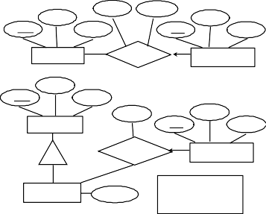
3. Entity vs Relationship
A manager gets a separate discretionary budget for each dept.
What if a manager gets a discretionary budget that covers all managed depts?
Redundancy: dbudget stored for each dept managed by manager.
ER Diagram 1
name
since dbudget
ssn
lot
budget
Employees
Manages2
Departments
name
ssn
lot
since
dname
Employees
did
budget
Manages2
Departments
ISA
This fixes the problem!
Managers
dbudget
ER Diagram 2

Slide 14
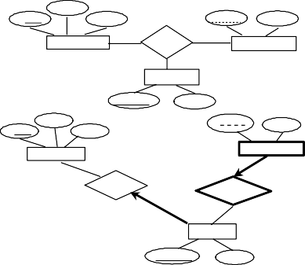
3. Binary vs Ternary Relationships
addr
Name ssN pname age
Employees
Bad design
Covers
Dependents
Policies
policyid
cost
name
ssn
Employees
pname
age
lot
Dependents
Purchaser
Beneficiary
Better design
Policies
policyid
cost
If each policy is owned by just 1 employee, and each dependent is tied to the covering policy, first diagram is inaccurate.

Slide 15
4. Generalization:
Kumar
Srinivas
Issac
Deepa
Entities are clubbed together to represent a more generalized view
Generalized entities contain the properties of all the generalized entities
Students
Notes:
15

Slide 16
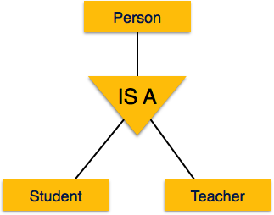
Specialization
Specialization is the opposite of generalization.
Group of entities is divided into sub-groups based on their characteristics
Notes:
16

Slide 17
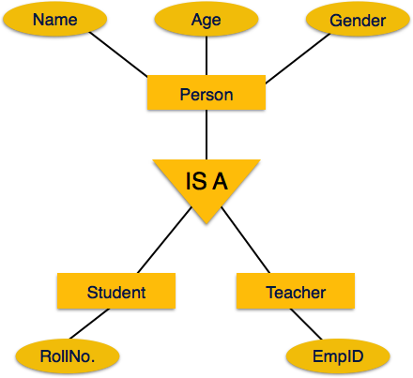
Inheritance
Important feature of Generalization and Specialization.
Allows lower-level entities to inherit the attributes of higher-level entities
Notes:
17

